Slide 1

Artificial Intelligence
Module Number: 3.2
Module Name: Knowledge and reasoning

Slide 2
Syllabus
Building a Knowledge Base, Knowledge Engineering, General Ontology, The Grocery Shopping World, Inference Rules Involving Quantifiers, Generalized Modus Ponens, Forward and Backward Chaining, Completeness, Resolution: A Complete Inference Procedure, Completeness of resolution

Slide 3
AIM:
To create computer programs that can solve problems and achieve goals like humans would.

Slide 4
Objectives:
To become familiar with basic principles of AI toward problem solving, inference, perception, knowledge representation, and learning.
Investigate applications of AI techniques in intelligent agents, expert systems, artificial neural networks, and other machine learning models.

Slide 5
Outcomes:
Apply basic principles of AI in solutions that require problem solving, inference, perception, knowledge representation, and learning.
Demonstrate awareness and a fundamental understanding of various applications of AI techniques in intelligent agents, expert systems, artificial neural networks, and other machine learning models.

Slide 6
Table of Content:
Building a Knowledge Base
Knowledge Engineering
General Ontology
The Grocery Shopping World
Inference Rules Involving Quantifiers
Generalized Modus Ponens
Forward and Backward Chaining
Completeness
Resolution: A Complete Inference Procedure
Completeness of Resolution

Slide 7
Knowledge Base
An intelligent agent needs knowledge about the real world for taking decisions and reasoning to act efficiently.
Knowledge-based agents are those agents who have the capability of maintaining an internal state of knowledge, reason over that knowledge, update their knowledge after observations and take actions. These agents can represent the world with some formal representation and act intelligently.
Knowledge-based agents are composed of two main parts:
Knowledge-base and
Inference system
Standard search
Notes:
Source -- https://www.javatpoint.com/knowledge-representation-in-ai

Slide 8
Knowledge Engineering
The process of building a knowledge base is called knowledge engineering and that is in the first-order logic.
A knowledge engineer is someone who investigates a particular domain, determines what concepts are important in that domain, and creates a formal representation of the objects and relations in the domain.
5 steps of Knowledge Engineering process.
Process of acquiring knowledge from experts and building knowledge base:
Narrow perspective
Knowledge acquisition, representation, validation, inference, maintenance
Broad perspective
Process of developing and maintaining intelligent system
Notes:
Source --http://wps.prenhall.com/wps/media/objects/1617/1656830/PPT11.ppt

Slide 9
Knowledge engineering processes
Acquisition of knowledge
General knowledge or meta-knowledge
From experts, books, documents, sensors, and files
Knowledge representation
Organized knowledge
Knowledge validation and verification
Inferences
Software designed to pass statistical sample data to generalizations
Explanation and justification capabilities
Notes:
Source : http://wps.prenhall.com/wps/media/objects/1617/1656830/PPT11.ppt
https://study.com/academy/lesson/knowledge-engineering-in-ai-definition-process-examples.html

Slide 10
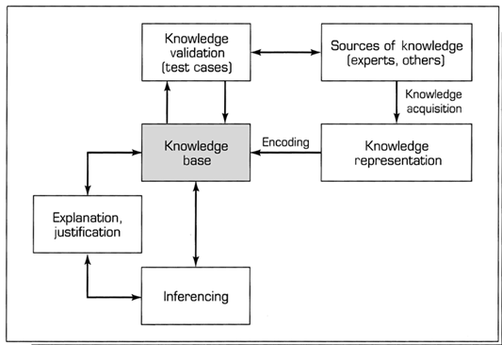
Knowledge engineering processes
Knowledge engineering processes
Notes:
Note – the image is taken from source --https://study.com/academy/lesson/knowledge-engineering-in-ai-definition-process-examples.html

Slide 11
General Ontology
Ontology Engineering:
Ontology engineering is a set of tasks related to the development of ontology's for a particular domain.
Defining terms in the domain and relations among them
Defining concepts in the domain (classes)
Arranging the concepts in a hierarchy (subclass-superclass hierarchy)
Defining which attributes and properties (slots) classes can have constraints on their values
Defining individuals and filling in property values
Notes:
Source -- https://www.cse.iitb.ac.in/~cs621-2011/2011-seminars/OntologyEngineering.ppt
An ontology is a speciﬁcation of a conceptualization. An ontology speciﬁes the meanings of the symbols in an information system.

Slide 12
Ontology Engineering Process
An iterative process
determine scope
consider reuse
enumerate
terms
consider reuse
define classes
enumerate
terms
define classes
determine scope
consider reuse
enumerate
terms
consider reuse
define classes
enumerate
terms
define classes
consider reuse
define properties
define constraints
create instances
Notes:
Source--https://www.cse.iitb.ac.in/~cs621-2011/2011-seminars/OntologyEngineering.ppt

Slide 13
The Grocery Shopping World
It is a Knowledge Engineering example where an agent helps a buyer to find product offers on the internet.
IN = product description (precise or ¬precise)
OUT = list of WebPages that offer the product for sale 
Environment = WWW 
Percepts = web pages (character strings)
Extracting useful information required
So domain knowledge is useful for Shopping agent.
Notes:
Source--https://cse.buffalo.edu/~shapiro/Courses/CSE563/Slides/krrSlides.pdf

Slide 14
The Grocery Shopping World
Find Relevant Product Offers 
RelevantOffer(page,url,query) ⇔ Relevant(page, url, query) ∧ Offer(page) 
Write axioms to define Offer(x) 
Find relevant pages: Relevant(x y z) ? 
Start from an initial set of stores.
What is a relevant category?
What are relevant connected pages?
Notes:
Source--https://cse.buffalo.edu/~shapiro/Courses/CSE563/Slides/krrSlides.pdf

Slide 15
The Grocery Shopping World
Require rich category vocabulary
Synonymy
ambiguity 
How to retrieve pages: GetPage(url) ?
Procedural attachment 
Compare offers (information extraction)
Notes:
Source--https://cse.buffalo.edu/~shapiro/Courses/CSE563/Slides/krrSlides.pdf

Slide 16
Organizing Knowledge for Shopping Agent
By decomposing the domain into clusters is for considering the tasks handling the agent. It is called functional decomposition.
Here it is divided (domain) into five clusters:
Menu Planning: The agent will need to know how to modify the shopping list when the
store is out of stock of an item.
Navigating: As in the wumpus world, the agent will need to understand the effect of
movement actions and create an internal map of the world.
Gathering: The agent must be able to find and gather the items it wants. Part of this
involves inducing objects from percepts.
Notes:
Source: Source--https://cse.buffalo.edu/~shapiro/Courses/CSE563/Slides/krrSlides.pdf

Slide 17
Organizing Knowledge for Shopping Agent
Communicating: The agent should be able to ask questions when there is something it
cannot find out on its own.
Paying: Even a shy agent that prefers not to ask questions will need enough inter-agent
skills to be able to pay the checkout clerk.
Notes:
Source: Source--https://cse.buffalo.edu/~shapiro/Courses/CSE563/Slides/krrSlides.pdf

Slide 18
Inference Rules
Generating the conclusions from evidence and facts is termed as Inference.
Inference rules are the templates for generating valid argument and Inference rules are applied to derive proofs in Artificial Intelligence.
Types of Inference rules:
Modus Ponens:
The Modus Ponens rule is one of the most important rules of inference, and it states that if P and P → Q is true, then we can infer that Q will be true.
Notation
Some terminologies of Inference Rule
Implication: It is one of the logical connectives which can be represented as P → Q. It is a Boolean expression.
Converse: The converse of implication, which means the right-hand side proposition goes to the left-hand side and vice-versa. It can be written as Q → P.
Contrapositive: The negation of converse is termed as contrapositive, and it can be represented as ¬ Q → ¬ P.
Inverse: The negation of implication is called inverse. It can be represented as ¬ P → ¬ Q.
P→Q, P
჻ Q
Notes:
Source: https://www.javatpoint.com/the-wumpus-world-in-artificial-intelligence

Slide 19
Inference Rules
Modus Tollens:
The Modus Tollens rule state that if P→ Q is true and ¬ Q is true, then ¬ P will also true.
Notation : P→Q, ~Q
~P
Hypothetical Syllogism:
The Hypothetical Syllogism rule state that if P→R is true whenever P→Q is true, and Q→R is true.
Disjunctive Syllogism:
The Disjunctive syllogism rule state that if P∨Q is true, and ¬P is true, then Q will be true.
Notation : P→Q, ¬ P
Q
Notes:
Source: https://www.javatpoint.com/the-wumpus-world-in-artificial-intelligence

Slide 20
Inference Rules
Addition:
The Addition rule is one the common inference rule, and it states that If P is true, then P∨Q will be true.
P
P˅Q
Simplification:
The simplification rule state that if P∧ Q is true, then Q or P will also be true.
P˄Q Or P˄Q
Q P
Resolution:
The Resolution rule state that if P∨Q and ¬ P∧R is true, then Q∨R will also be true.
P˅Q , ¬ P˄R
Q˅R
Notes:
Source: https://www.javatpoint.com/the-wumpus-world-in-artificial-intelligence

Slide 21
InfereaInference Rules for Quantifiernce Rules
Some inference rules for quantifiers
Universal Generalization
Universal Instantiation
Existential Instantiation
Existential Introduction
Universal Generalization:
Universal Generalization is a valid inference rule which states that if premise P(c) is true for any arbitrary element c in the universe of discourse, then we can have a conclusion as ∀ x P(x).
Notes:
Source: https://www.javatpoint.com/the-wumpus-world-in-artificial-intelligence

Slide 22
Inference Rules for Quantifier
Existential Instantiation:
Existential Instantiation is also called as Existential Elimination, which is a valid inference rule in first-order logic.
It can be applied only once to replace the existential sentence.
The new KB is not logically equivalent to old KB, but it will be satisfiable if old KB was satisfiable.
This rule states that one can infer P(c) from the formula given in the form of ∃x P(x) for a new constant symbol c.
The restriction with this rule is that c used in the rule must be a new term for which P(c) is true.
Notes:
Source: https://www.javatpoint.com/the-wumpus-world-in-artificial-intelligence

Slide 23
Inference Rules for Quantifier
Inference Rules for Quantifier
Existential Introduction
An Existential Introduction is also known as an Existential Generalization, which is a valid inference rule in first-order logic.
This rule states that if there is some element c in the universe of discourse which has a property P, then we can infer that there exists something in the universe which has the property P.
Notes:
Source: https://www.javatpoint.com/the-wumpus-world-in-artificial-intelligence

Slide 24
Generalized Modus Ponens (GMP)
p₁', p₂', … , p_{n}', ( p₁ ∧ p₂ ∧ … ∧ p_{n} ⇒q)
qθ
p₁' is King(John) p₁ is King(x)
p₂' is Greedy(y) p₂ is Greedy(x)
θ is {x/John,y/John} q is Evil(x)
q θ is Evil(John)
GMP used with KB of definite clauses (exactly one positive literal)
All variables assumed universally quantified
where p_{i}'θ = p_{i} θ for all i
Notes:
http://aima.eecs.berkeley.edu/slides-ppt/m9-inference.ppt

Slide 25
Soundness of GMP
Need to show that,
p₁', …, p_{n}', (p₁ ∧ … ∧ p_{n} ⇒ q) ╞ qθ
provided that p_{i}'θ = p_{i}θ for all I
Lemma: For any sentence p, we have p ╞ pθ by UI
(p₁ ∧ … ∧ p_{n} ⇒ q) ╞ (p₁ ∧ … ∧ p_{n} ⇒ q)θ = (p₁θ ∧ … ∧ p_{n}θ ⇒ qθ)
p₁', \; …, \;p_{n}' ╞ p₁' ∧ … ∧ p_{n}' ╞ p₁'θ ∧ … ∧ p_{n}'θ
From 1 and 2, qθ follows by ordinary Modus Ponen
Notes:
http://aima.eecs.berkeley.edu/slides-ppt/m9-inference.ppt

Slide 26
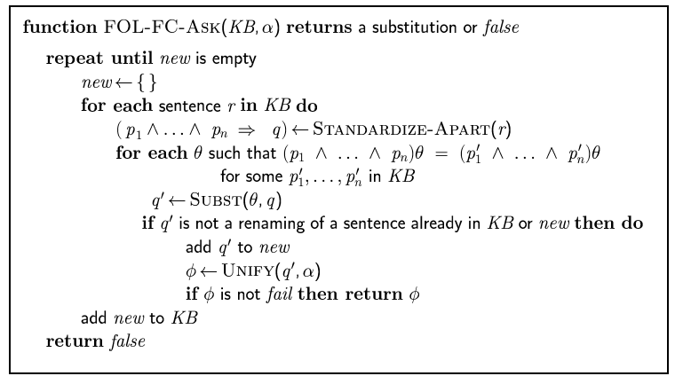
Forward Chaining Algorithm
Notes:
Note : The image is taken from the source ---http://aima.eecs.berkeley.edu/slides-ppt/m9-inference.ppt

Slide 27
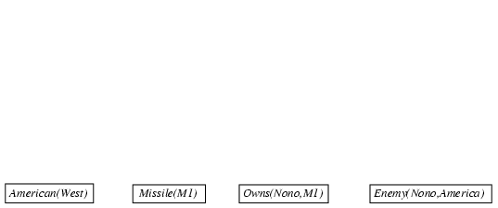
Forward Chaining Proof
Notes:
Note : The image is taken from the source ---http://aima.eecs.berkeley.edu/slides-ppt/m9-inference.ppt

Slide 28
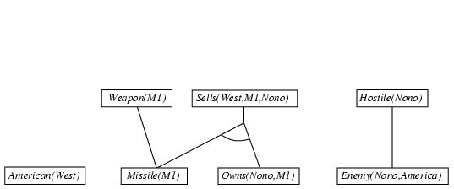
Forward Chaining Proof
Notes:
Note : The image is taken from the source ---http://aima.eecs.berkeley.edu/slides-ppt/m9-inference.ppt

Slide 29
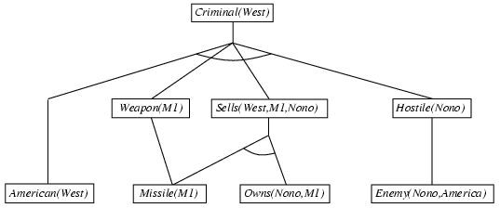
Forward Chaining Proof
Notes:
Note : The image is taken from the source ---http://aima.eecs.berkeley.edu/slides-ppt/m9-inference.ppt

Slide 30
Properties of Forward Chaining
Sound and complete for first-order definite clauses.
Data log = first-order definite clauses + no functions.
FC terminates for Data log in finite number of iterations.
May not terminate in general if α is not entailed.
This is unavoidable: entailment with definite clauses is semi-decidable.
Notes:
source ---http://aima.eecs.berkeley.edu/slides-ppt/m9-inference.ppt

Slide 31
Efficiency of Forward Chaining
Incremental Forward Chaining: no need to match a rule on iteration k if a premise wasn't added on iteration k-1.
⇒ match each rule whose premise contains a newly added positive literal
Matching itself can be expensive:
Database indexing allows O(1) retrieval of known facts.
e.g., query Missile(x) retrieves Missile(M₁)
Forward chaining is widely used in deductive databases.
Notes:
the source ---http://aima.eecs.berkeley.edu/slides-ppt/m9-inference.ppt

Slide 32
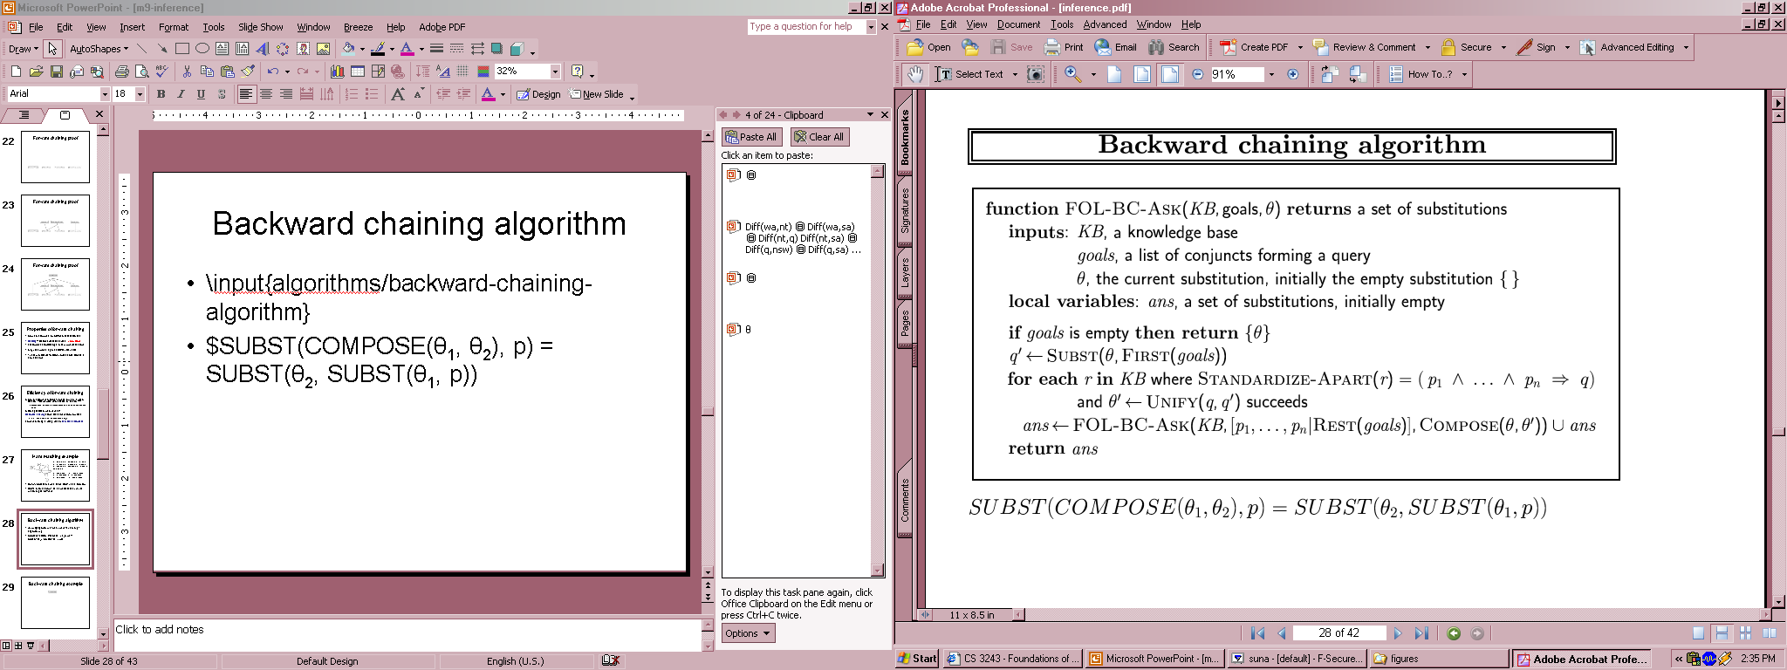
Backward Chaining Algorithm
SUBST(COMPOSE(θ₁, θ₂), p) = SUBST(θ₂, SUBST(θ₁, p))
Notes:
Note : The image is taken from the source ---http://aima.eecs.berkeley.edu/slides-ppt/m9-inference.ppt

Slide 33

Backward Chaining Algorithm
Notes:
Note : The image is taken from the source ---http://aima.eecs.berkeley.edu/slides-ppt/m9-inference.ppt

Slide 34
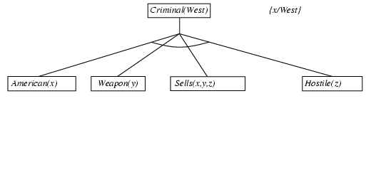
Backward Chaining Algorithm
Notes:
Note : The image is taken from the source ---http://aima.eecs.berkeley.edu/slides-ppt/m9-inference.ppt

Slide 35
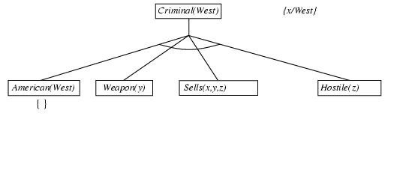
Backward Chaining Algorithm
Notes:
Note : The image is taken from the source ---http://aima.eecs.berkeley.edu/slides-ppt/m9-inference.ppt

Slide 36
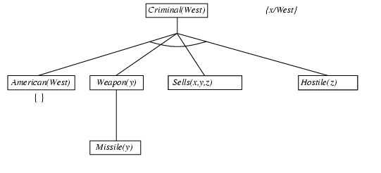
Backward Chaining Algorithm
Notes:
Note : The image is taken from the source ---http://aima.eecs.berkeley.edu/slides-ppt/m9-inference.ppt

Slide 37
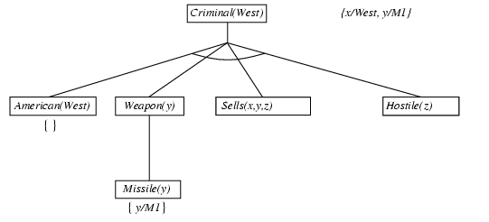
Backward Chaining Algorithm
Notes:
Note : The image is taken from the source ---http://aima.eecs.berkeley.edu/slides-ppt/m9-inference.ppt

Slide 38
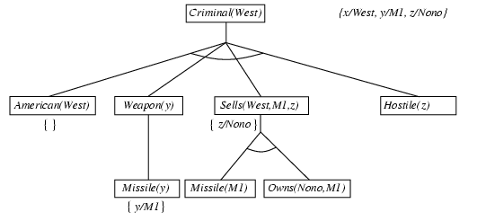
Backward Chaining Algorithm
Notes:
Note : The image is taken from the source ---http://aima.eecs.berkeley.edu/slides-ppt/m9-inference.ppt

Slide 39
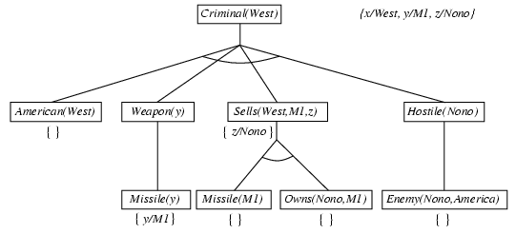
Backward Chaining Algorithm

Slide 40
Backward Chaining Algorithm
Notes:
Note : The image is taken from the source ---http://aima.eecs.berkeley.edu/slides-ppt/m9-inference.ppt

Slide 41
Properties of Backward Chaining
Depth-first recursive proof search: space is linear in size of proof
Incomplete due to infinite loops
⇒ fix by checking current goal against every goal on stack
Inefficient due to repeated sub goals (both success and failure)
⇒ fix using caching of previous results (extra space)
Widely used for logic programming
Notes:
source ---http://aima.eecs.berkeley.edu/slides-ppt/m9-inference.ppt

Slide 42
Completeness
ⱯX ¬P(x) => R(x) cannot be converted to Horn form, and thus cannot be used by Modus Ponens. So we can say the proof procedure using Modus Ponens is incomplete.
Comapleteness Theorem
In first-order logic, any sentence that is entailed by another set of sentences can be proved from that set. Thus, we can find inference rules that allow a complete proof procedure R, which can be represented as if KB ╞ α then KB Ͱ _{R} ª

Slide 43
Resolution : A Complete Inference Procedure
Resolution is a theorem proving technique that proceeds by building refutation proofs, i.e., proofs by contradictions.
Resolution is used, if there are various statements given, and we need to prove a conclusion of those statements. Unification is a key concept in proofs by resolutions. Resolution is a single inference rule, which can efficiently operate on the conjunctive normal form or clausal form.
Soundness of resolution inference rule:
¬(l_{i} ∨ … ∨ l_{i-1} ∨ l_{i+1} ∨ … ∨ l_{k}) ⇒ l_{i}
¬m_{j} ⇒ (m₁ ∨ … ∨ m_{j-1} ∨ m_{j+1} ∨... ∨ m_{n})
¬(l_{i} ∨ … ∨ l_{i-1} ∨ l_{i+1} ∨ … ∨ l_{k}) ⇒ (m₁ ∨ … ∨ m_{j-1} ∨ m_{j+1} ∨... ∨ m_{n})
Notes:
Source --http://aima.eecs.berkeley.edu/slides-ppt/m7-logic.ppt

Slide 44
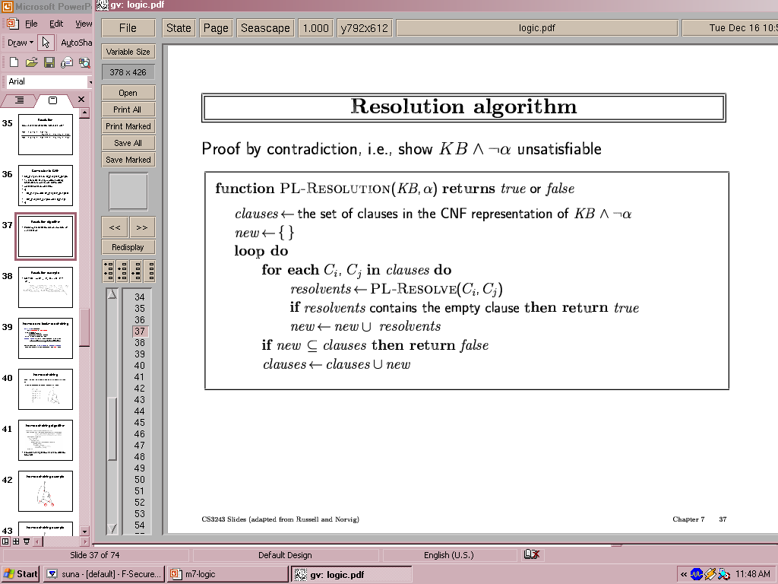
Resolution Algorithm
Proof by contradiction, i.e., show KB➢α unsatisfiable
Notes:
Note : The image is taken from the source ---http://aima.eecs.berkeley.edu/slides-ppt/m7-logic.ppt

Slide 45
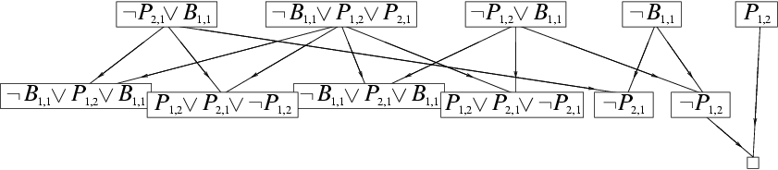
Resolution Example
KB = (B1,1  (P1,2 P2,1)) ➢ B1,1 α = ➢P1,2
Steps for Resolution:
Conversion of facts into first-order logic.
Convert FOL statements into CNF.
Negate the statement which needs to prove (proof by contradiction).
Draw resolution graph (unification).
Notes:
Note : The image is taken from the source ---http://aima.eecs.berkeley.edu/slides-ppt/m7-logic.ppt

Slide 46
Completeness of Resolution
Resolution is a refutation complete inference procedure for the First-Order Logic.
If a set of sentences contains a contradiction, then a finite sequence of resolutions will prove this.
If not, resolution may loop forever (“semi-decidable”).
Refutation Completeness: If KB |= A then KB |- A
If it’s entailed, then there’s a proof.
Notes:
Source--https://people.cs.pitt.edu/~wiebe/courses/CS2710/lectures/chapter9.ppt

Slide 47
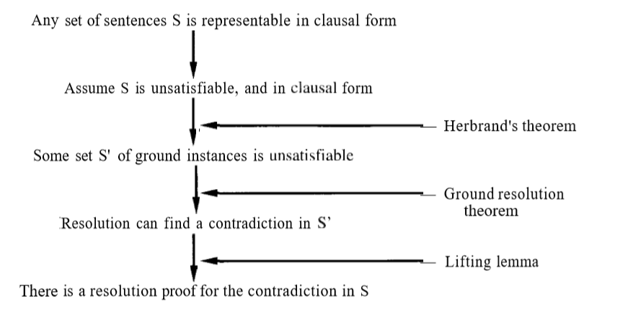
Structure of a Completeness Proof for Resolution
Notes:
Source : https://www.cin.ufpe.br/~tfl2/artificial-intelligence-modern-approach.9780131038059.25368.pdf

Slide 48
Self Assessment Questions
Inference algorithm is complete only if _____________.
It can derive any sentence
It can derive any sentence that is an entailed version
It is truth preserving
It can derive any sentence that is an entailed version & is truth preserving
Answer: d.

Slide 49
Self Assessment Questions
Which one of the given options is not a Familiar Connectives in the First Order Logic?
And
Iff
Or
Not
Answer: d.

Slide 50
Self Assessment Questions
Which is not a property of representation of knowledge?
Representational Verification
Representational Adequacy
Inferential Adequacy
Inferential Efficiency
Answer: a.

Slide 51
Self Assessment Questions
Knowledge and reasoning also play a crucial role in dealing with __________________ environment.
Completely Observable
Partially Observable
Neither Completely nor Partially Observable
Only Completely and Partially Observable
Answer: b.

Slide 52
Self Assessment Questions
The corresponding Existential Instantiation rule: for the existential quantifier is slightly more complicated. For any sentence a, variable v, and constant symbol k that does not appear elsewhere in the knowledge base. Is the above statement true or false?
True
False
Answer: a.

Slide 53
Self Assessment Questions
What among the following could be the universal instantiation of ___________ For all x King(x) ^ Greedy(x) => Evil(x).
King(John) ^ Greedy(John) => Evil(John)
King(y) ^ Greedy(y) => Evil(y)
King(Richard) ^ Greedy(Richard) => Evil(Richard)
All of the mentioned
Answer: d.

Slide 54
Self Assessment Questions
Which one of the given options is not the style of inference?\
Forward Chaining
Backward Chaining
Resolution Refutation
Modus Ponen
Answer: d.

Slide 55
Self Assessment Questions
What are the two basic types of inferences?
Reduction to propositional logic, Manipulate rules directly
Reduction to propositional logic, Apply modus ponen
Apply modus ponen, Manipulate rules directly
Convert every rule to Horn Clause, Reduction to propositional logic
Answer: a.

Slide 56
Self Assessment Questions
Translate the given statement into FOL. “For every a, if a is a PhD student, then a has a master degree.”
∀ a PhD(a) -> Master(a)
∃ a PhD(a) -> Master(a)
A is true, B is true
A is false, B is false
Answer: a.

Slide 57
Self Assessment Questions
Forward chaining systems are _____________ where as backward chaining systems are ___________.
Goal-driven, goal-driven
Goal-driven, data-driven
Data-driven, goal-driven
Data-driven, data-driven
Answer: c.

Slide 58
Assignment
Which component derives new knowledge using inference rules in an AI program?
Explain any two points of difference between forward reasoning and backward reasoning inference mechanism.
You are given old assertions and you have to derive new assertions from the same. Which inference mechanism would be appropriate? Why?

Slide 59
Assignment
Consider the following clausal form:
isa(X, living_thing) <- isa(X, animate)
isa(X, animate) <- isa(X, human)
isa(X, human) <- isa(X, man)
isa(Jay, man)
Represent forward reasoning inference.
Represent backward reasoning inference.

Slide 60
Document Link
Topic | URL | Notes
Knowledge Base Ontology | https://en.wikipedia.org/wiki/Artificial_intelligence | Outline knowledge base and general ontology strategies with their representation and example.
Inference Rules Modus Ponens Forward and Backward Chaining | https://www.javatpoint.com/knowledge-based-agent-in-ai | Explains about inference rules for quantifiers , chaining and how they are used in artificial intelligence concept.
Resolution | https://www.javatpoint.com/ai-resolution-in-first-order-log | Summarize the Resolution and completeness of Resolution.

Slide 61
Video Link
Topic | URL | Notes
Knowledge Base Ontology | https://www.youtube.com/watch?v=7Rz47HnTZ_k | Outline knowledge base and general ontology strategies with their representation and an example.
Inference Rules Modus Ponens | https://www.youtube.com/watch?v=NTSZMdGlo4g | Explains about inference rules for quantifiers and how they are used in artificial intelligence concept.
Forward and Backward Chaining | https://www.youtube.com/watch?v=Dso6EKzvXHo | Describe about forward and backward chaining and how they are used in artificial intelligence concept.
Resolution | https://www.youtube.com/watch?v=C_iqWGOhvak | Summarize the resolution and completeness of resolution.

Slide 62
E- Book Link
Ebook name | Chapter | Page No. | Notes | URL
Artificial Intelligence: A Modern Approach by Stuart Russell and Peter Norvig, c 1995 Prentice-Hall, Inc. | Chapter 8 | 217-261 | Give a description about different types of knowledge engineering and ontology rules with examples. | https://www.cin.ufpe.br/~tfl2/artificial-intelligence-modern-approach.9780131038059.25368.pdf
Artificial Intelligence: A Modern Approach by Stuart Russell and Peter Norvig, c 1995 Prentice-Hall, Inc. | Chapter 9 | 265-294 | Give a description about different types of inference rules in first order logic and chaining with examples. | https://www.cin.ufpe.br/~tfl2/artificial-intelligence-modern-approach.9780131038059.25368.pdf

